Slide 1

Toward Transparency 3.0:
A Data Value Chain Assessment of Transparency 2.0
2025.11.26
Development Futures Lab
Global Research Institute at Korea University
for
IATI Members’ Assembly and Community Exchange 2025
Nairobi, Kenya

Slide 2


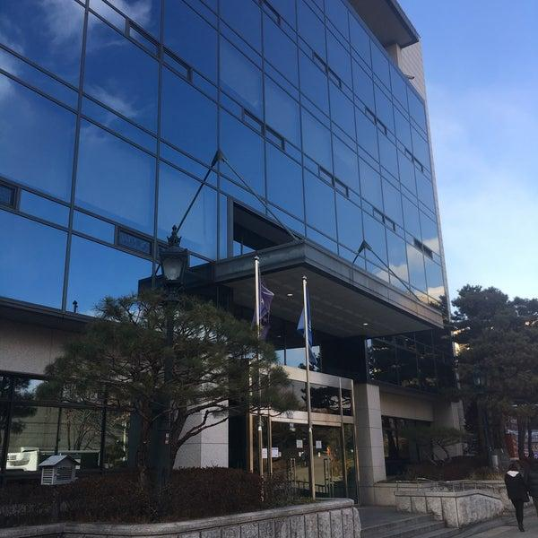
Development Futures Lab (KU DFLab)
Description
Located within the Global Research Institute (GRI) at the Graduate School of International Studies at Korea University, KU DFLab works to envision, evaluate, and engender future development by predicting how future socioeconomic transformations will impact development and by exploring the potential contributions of emerging technologies.
Mission
The core mission of the KU DFLab is to forge innovative, data-driven policy solutions that significantly improve the efficiency, transparency, and overall impact of global development initiatives.
https://www.cuzproduces.com/dflab/

Slide 3

Project Overview: Assess Transparency 2.0
Data Availability and Usability in
Data-Based Decision-Making for Development
Funding: LVG from UNDP Seoul Policy Centre (USPC)
Dates: 1 April 2024 to 31 March 2025
Identified Challenges
Anecdotal evidence of underperformance: difficulties in obtaining necessary information
Challenges in user experience, data collection, and database design
Research Objectives
Assess the IATI data, its interfaces, and user experiences (focus on d-Portal)
Identify areas for enhancement: data collection, data access, interface usability and training

Slide 4
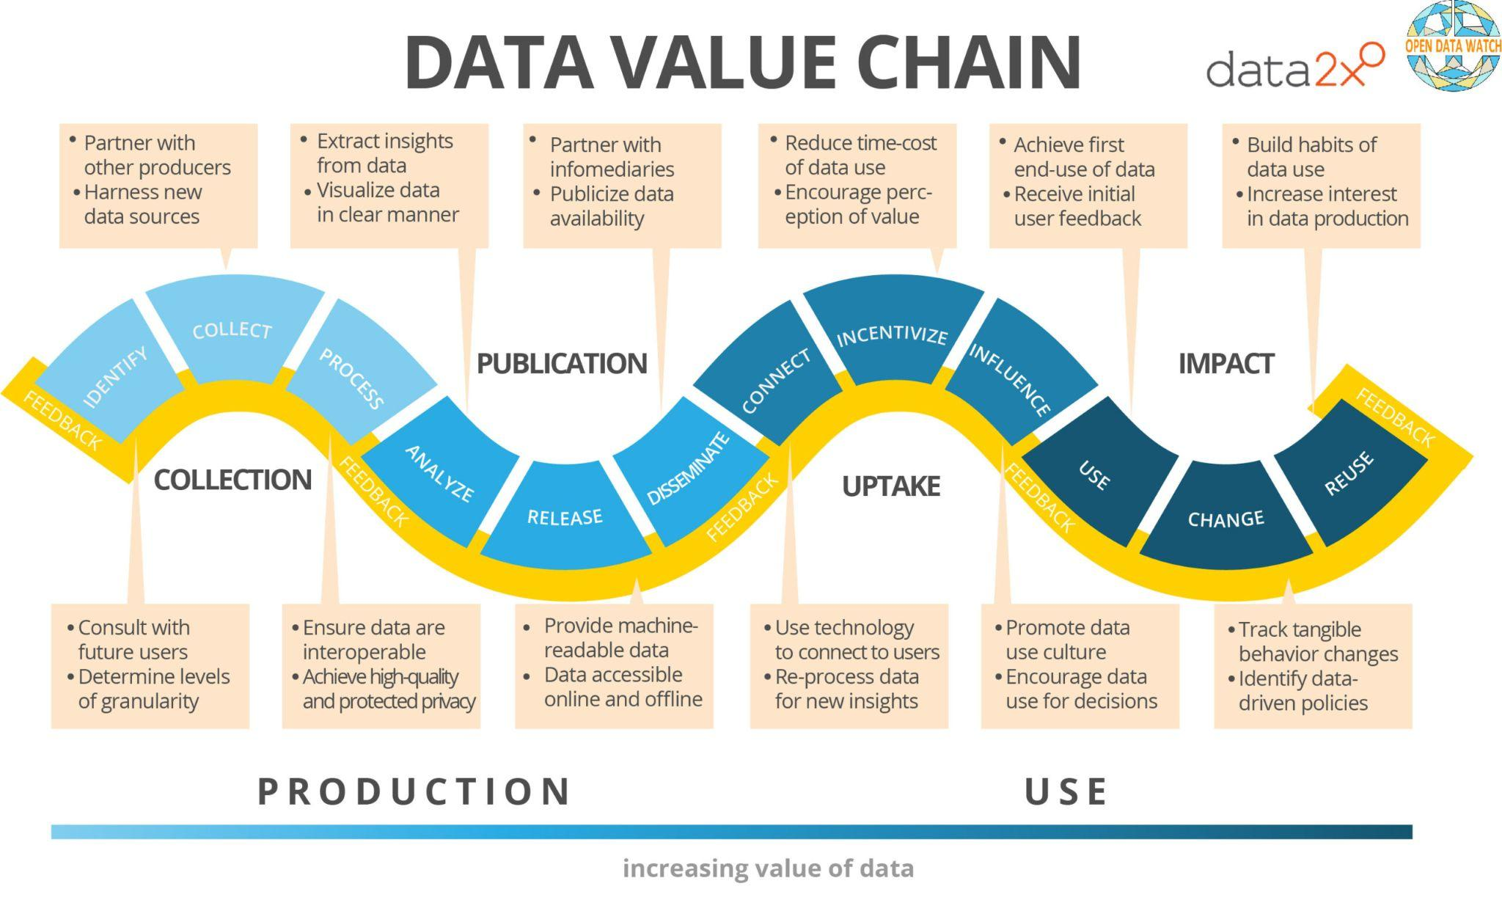
2. Conceptual framework: Data Value Chain (DVC)

Slide 5


3. Methodology
1 Technical & Document Review
2 Structured Interviews
3 Scenario Walkthroughs
Reviewed IATI’s published documents, such as official reports and meeting minutes, to identify patterns. With support from a data fellow, DFL examined IATI’s data architecture using Python.
Conducted interviews with IATI users, gaining qualitative insights into their experiences with the platform and its data ecosystem.
Under the guidance of practitioner partners, DFL devised potential use cases of IATI d-portal to assess its viability as a decision support system. Primarily d-Portal.

Slide 6
User base: Different motivations
UNDP HQ
UNDP CO
DevelopmentProviders
Development Partners
Other users
3 Scenario Walkthroughs
UNDP HQ
Enhance aid planning and transparency of aid related activities
Utilize IATI data as a supplementary tool to enhance project planning and informed management decisions
Tracking budgetary expenditures, ensuring transparency for stakeholders
Facilitate informed decision-making and improve coordination with donors and development partners (aid implementers)
Data integration, reporting, investigative journalism, and transparency monitoring

Slide 7
Walk-through scenarios
Scenario One
Scenario Four
Scenario Six
(Actor) Health Official
(Topic) Vector-borne Disease Aid Assistance
(Scenario) I am a government official in the CDC equivalent of a country in Latin America. I need to find an NGO with a track record of working in Latin America, with experience dealing with infectious disease transmission. Ideally, the NGO should have a track record of not going over budget and completing projects on time.
(Actor) Policy Maker in a Donor Country
(Topic) Aid Portfolio
(Scenario) I am a policy maker from a donor country evaluating the allocation of our country's aid to South America. I use IATI to analyze our aid's distribution across different sectors (health, education, infrastructure) and its alignment with our strategic goals, ensuring that our international aid portfolio is balanced and effective.
(Actor) UNDP Analyst
(Topic) MEA Gender Equality Initiatives
(Scenario) As a UNDP analyst, I am tasked with preparing a comprehensive report on gender equality projects funded in the Middle East. I use IATI to gather data on the scope, funding, and outcomes of these projects to assess trends and prepare recommendations for future funding directions.

Slide 8
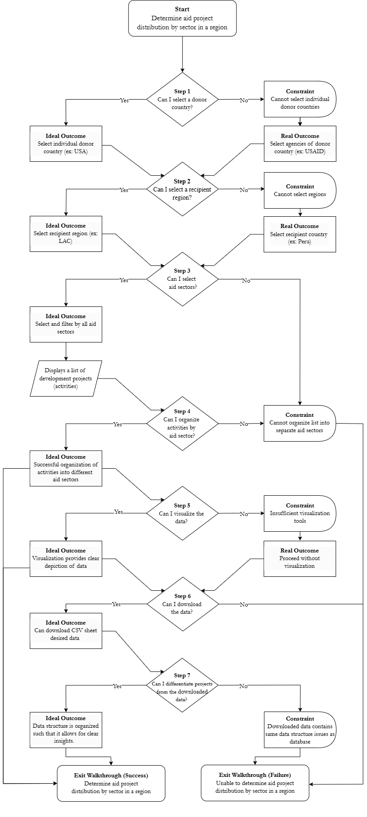
Walk-through scenario flow chart sample

Slide 9
Analytical framework: Evaluation criteria (Wang and Strong 1992)
Dimension(s) | Component
Intrinsic Quality | Accuracy (reflects real-world conditions and free from errors or inconsistencies)
 | Objectiveness
 | Credibility
Contextual Relevance | Completeness (captures all necessary information)
 | Timeliness (current and up-to-date)
 | Appropriateness (aligns with the specific needs of its users)
Representational Clarity | Interpretability (clarity and coherence)
 | Consistency (follows uniform formats, definitions, and structures)
Accessibility | Ease of use

Slide 10
4. General findings
Major improvement over time
Moving target
Better for transparency than aid planning
Project documents probably an underutilized asset
Voluntary nature will remain a challenge
Positioned to take IATI to another level

Slide 11
Specific findings
Dimension(s) | Problem | Observable as…
Intrinsic Quality Accuracy | Lack of project validation | Mismatch between budget and expenditure in CDFD (e.g., new funding or carryovers?)
 | Lack of unique identifiers | Duplicate identifiers
Contextual Relevance Completeness | Incomplete data inputs | Missing data
Contextual Relevance Timeliness | Irregular data updates | Outdated data
Contextual Relevance Appropriateness | Structural inefficiencies for real-time use | Delayed responses for queries using SQL/API

Slide 12
Specific findings
Dimension(s) | Problem | Observable as…
Representational Clarity Interpretability | Absence of standardized attribute constraints | Inputs in different languages
Representational Clarity Consistency | Lack of clear roles among IATI tools | Inconsistent query responses between tools
Accessibility Ease of use | Inability to view trends both in time and across regions | Only individual countries/years selectable
 | Fragmented donor scales | Lack of linkage between multiple donor agencies in same country
 | Lack of single/multifunding differentiation | Projects reported an individual basis
 | Lack of visualizations | Non-interactive visualizations
User Capacity | Varying degrees of user capacity | Varying demands on IATI

Slide 13
Compiled findings and suggestions
Issues
Impacted Actors
Data Value Chain
Solutions
(Intrinsic Quality)
Other
Users
Dev’t Partners
Dev’t Providers
UNDP CO
UNDP HQ
Identify
1
Integrated Data Compliance System
Other
Users
UNDP HQ
COLLECTION
2
Integrated Validation System
#1. Lack of Project Validation
1
Collect
#2. Lack of Unique Identifiers
Unified Identifier System
UNDP HQ
Process
(Contextual Relevance)
2
LLM-forward Data Preparation
UNDP HQ
#3. Incomplete Data Inputs
3
Analyze
Multilingual Data Standardization System
#4. Irregular Data Updates
UNDP HQ
Release
PUBLICATION
3
Query Response Time Improvement
Dev’t Partners
UNDP CO
UNDP HQ
4
#5. Structural Inefficiencies for Real-time Use
Dev’t Providers
Interface enhancements
(Representational Clarity)
Disseminate
#6. Absence of Standardized Attribute Constraints
DATA VALUE CHAIN
Project Funding Classification System
Other
Users
UNDP CO
UNDP HQ
Connect
4
#7. Lack of Clear Roles among IATI Tools
Comprehensive Data Visualization System
Other
Users
Dev’t Partners
Dev’t Providers
UPTAKE
(Accessibility)
5
Incentivize
Donor Funding Coordination System
#8. Inability View Trends both in Time & Across Regions
Dev’t Providers
Influence
5
User-Adaptive Navigation System
#9. Fragmented Donor Scales
Dev’t Providers
Guided Recommendation Engine
Other
Users
Dev’t Partners
Dev’t Providers
Use
#10. Lack of Single/Multifunding Differentiation
6
UNDP CO
6
Integrating Learning Navigation System
#11. Lack of Visualizations
Change
IMPACT
Other
Users
Dev’t Partners
Dev’t Providers
AI-Driven Donor Activity Registry (DAR)
(User Capacity)
Other
Users
Dev’t Partners
Dev’t Providers
Reuse
Aid Data Standards Association (ADSA)
#12. Varying Degrees of User Capacity

Slide 14
5. Toward Transparency 3.0
Centralized, AI-forward management, analysis and prediction
1 Centralization
2 LLM-assisted input
3 Predictive modeling
Robust validation → higher data quality
Structured database and robust backend → faster response time
Lower publishing costs → true DPG
Convert project documents to text → better searchability and analysis
Pre-populate fields from project documents → lower publishing costs
Flag discrepancies and missing data → higher quality data
Integrated ML and statistical models → better forecasting → better aid planning
Robust data visualization → stronger communication tools + uptake by less sophisticated users

Slide 15

Thank you!
Development Futures Lab
Korea University
dflab@korea.ac.kr
Find us at https://cuzproduces.com/dflab

Slide 16
Appendix
dflab@korea.ac.kr
Find us at https://cuzproduces.com/dflab

Slide 17
A. Suggestions
Phase | Solution | Description | Complexity
Collection | Integrated Data Compliance System | Standardizes data entry across platforms, ensuring consistency and reducing redundancy. | Low
 | Integrated Validation System | Enhances IATI’s Validator to enforce data quality and prevent missing values. | Low
 | Unified Identifier System | Introduces unique project identifiers to improve data traceability. | Medium
 | LLM-forward Data Preparation | Converts project documents to plain text to pre-populate fields and to improve searchability and analysis. | Medium
 | Multilingual Data Standardization System | Uses AI-powered translation to ensure data interoperability across languages. | High

Slide 18
A. Suggestions
Phase | Solution | Description | Complexity
Publication | Query Response Time Improvement | Optimizes platform performance to reduce response times for user queries. | Low
 | Interface enhancements | Adds filtering and identifies related projects | Low
 | Project Funding Classification System | Adds metadata tagging and financial breakdown tools for project funding clarity. | Medium
 | Comprehensive Data Visualization System | Expands visualization tools, including interactive charts and regional comparisons. | Medium
 | Donor Funding Coordination System | Uses AI to detect funding overlaps and improve aid coordination. | High

Slide 19
A. Suggestions
Phase | Solution | Description | Complexity
Uptake | User-Adaptive Navigation System | Directs users to the most relevant tools based on their skill level and needs. | Medium
 | Guided Recommendation Engine | Automates tool recommendations to improve user onboarding. | Medium
Impact | Integrated Learning Navigation System | Embeds guidance and tutorials within the platform to enhance data analytics. | Medium
 | AI-Driven Donor Activity Registry (DAR) | Automates aid flow categorization to reduce redundancy and improve funding efficiency. | High
 | Aid Data Standards Association (ADSA) | Establishes a forum for standard-setting and improving IATI data applications. | High

